Slide 1
Heap Spray
CSC 840 – Spring 2016
Josh Stroschein

Slide 2
Why I/You care
Heap Spray is a common technique associated withy UaF
Heap spraying is a payload delivery technique
Often used in conjunction with Use-After-Free (UaF)
Place payload in a predictable place in memory
jump or return to it later
Provides underlying theory for more advanced exploitation techniques (bypasses)

Slide 3
Three Main Ideas
What is the heap and how does it differ from the stack
How to create a heap spray
How to analyze your heap spray using a debugger - Immunity and WinDBG

Slide 4
Heap V. Stack
Each thread has it’s own stack
Limited and fixed in size
Heap is used to deal with dynamic memory allocation
Application may be unsure how much data it will need
Usually one heap per application
Heap (manager) has access to larger amount of virtual memory when compared to the stack
Heap memory can be allocated in a variety of ways
VirtualAlloc, malloc, etc
Heap allocations are eventually freed

Slide 5
Why Heap Spray?
Deliver a payload
Try to place shellcode at a reliable address
Fill memory with your shellcode, then gain control of EIP
We’ll use JavaScript via the browser (IE) for the demo
What happens:
Spray the heap
Trigger the bug
Control EIP and point EIP into the heap

Slide 6
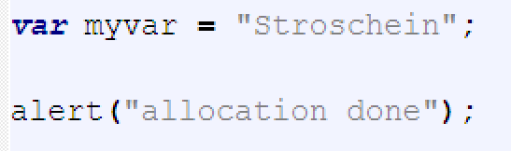
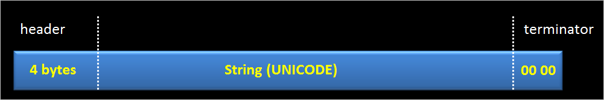
String Allocation – The Way It Was...
BSTR String Object
Source: https://www.corelan.be/index.php/2011/12/31/exploit-writing-tutorial-part-11-heap-spraying-demystified/

Slide 7
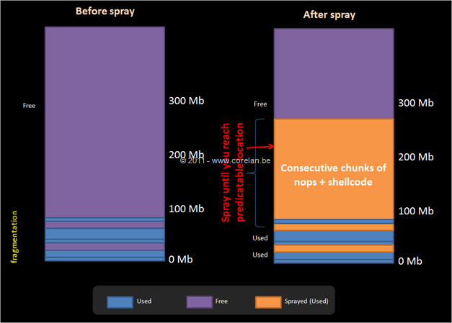
Heap Spray
Source: https://www.corelan.be/index.php/2011/12/31/exploit-writing-tutorial-part-11-heap-spraying-demystified/

Slide 8
Future Direction
IE disrupted the way strings were allocated
Look into DOM objects for more current attack techniques
Extend example by looking into precise heap sprays
Add shellcode w/ ROP
Bypass DEP
Look into heap spray + UaF

Slide 9
Resources
Corelan:
https://www.corelan.be/index.php/2011/12/31/exploit-writing-tutorial-part-11-heap-spraying-demystified/

